Slide 1
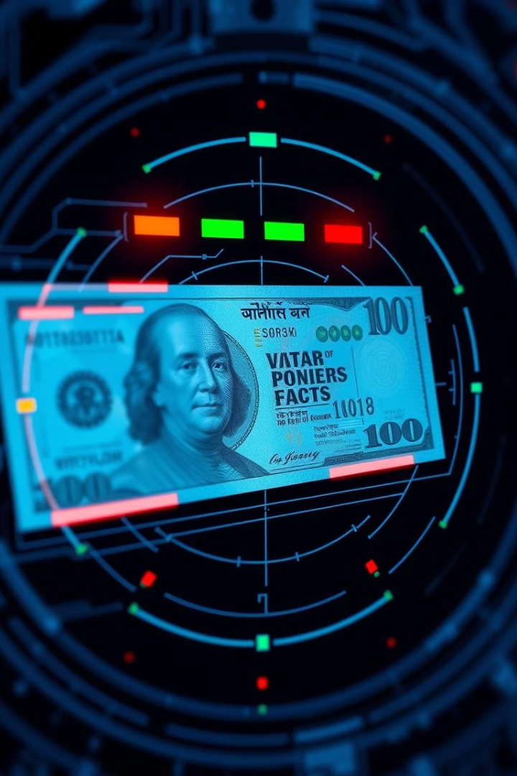
Detecting Fake Currency with Machine Learning
This presentation explores a classification model for identifying fake currency notes. We'll cover the dataset, methodology, and model performance.

Slide 2





Dataset Overview
Source: data_banknote_authentication.csv
Target:
Features: Variance, Skewness, Kurtosis, Entropy
Shape:
Class (0=Fake, 1=Genuine)
1371 Rows, 5 Columns
A compact dataset for efficient modeling.
Publicly available dataset for banknote authentication.
Binary classification for note authenticity.
Statistical measures from wavelet-transformed images.

Slide 3
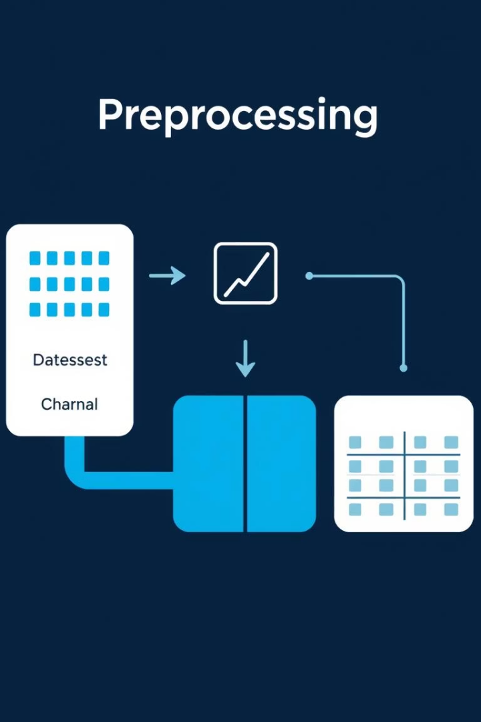



Data Preprocessing Steps
No Missing Values
Dataset is complete and ready for use.
Feature Scaling
StandardScaler improves model convergence.
Data Split
Train/test split ensures unbiased evaluation.

Slide 4
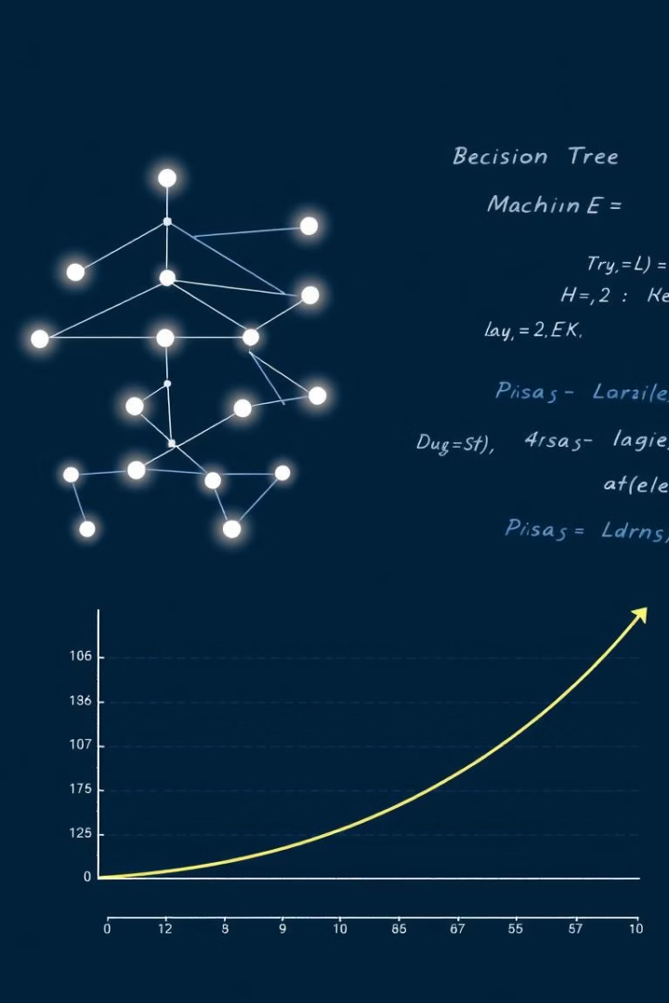
Classification Modeling Approach
1
Model Selection
Logistic Regression, SVM, or Random Forest were viable.
2
Training
Models trained on the preprocessed training data.
3
Prediction
Inferences made on unseen test data.
4
Evaluation
Performance assessed using classification metrics.

Slide 5
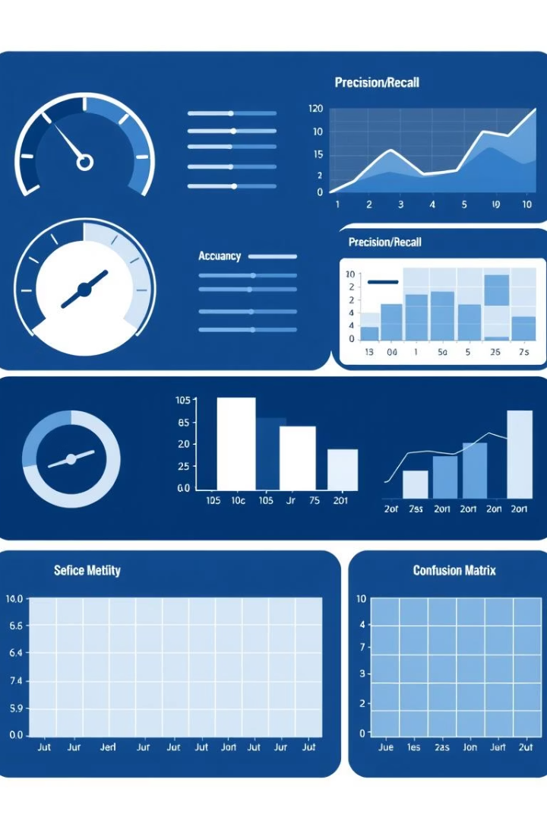
Model Performance Evaluation
Accuracy
Overall correct classifications.
Precision & Recall
Balances false positives/negatives.
F1-score
Harmonic mean of precision and recall.
Confusion Matrix
Visualizes prediction outcomes.
ROC AUC Score
Measures discriminative power.

Slide 6
Understanding the Confusion Matrix
True Negatives (TN)
True Positives (TP)
False Positives (FP)
False Negatives (FN)
Correctly identified fake notes.
Correctly identified genuine notes.
Fake notes incorrectly classified as genuine.
Genuine notes incorrectly classified as fake.

Slide 7
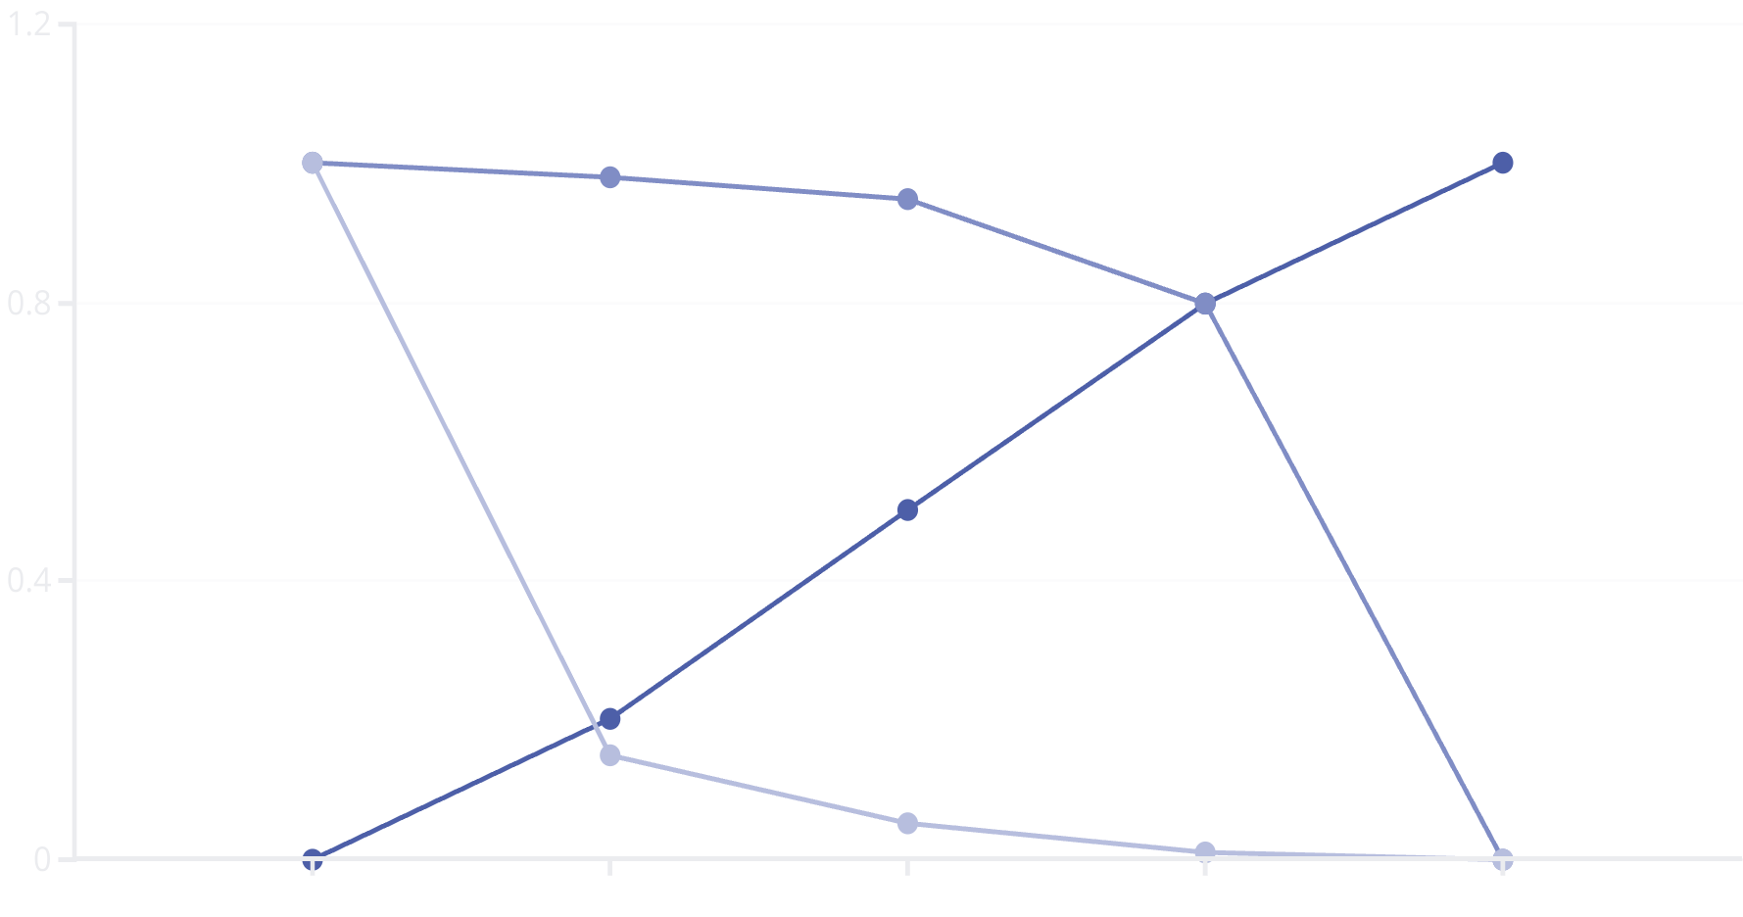
ROC Curve:
Threshold
True Positive Rate
False Positive Rate
The ROC curve plots TPR vs. FPR at various thresholds. A high AUC score (close to 1.0) signifies excellent model performance. It shows the model's ability to distinguish between classes.

Slide 8

Conclusion:
Model Success
Critical Factors
Successfully built a highly accurate fake currency detection model.
Preprocessing and feature engineering were key to performance.
Future Work
Explore ensemble methods, deep learning, and real-time deployment.

